Slide 1


Microservice Development for Blob Storage at Apptio
Capstone Presentation
Trenton Mueller
Advisor: Dr. Arnold Lund

Slide 2

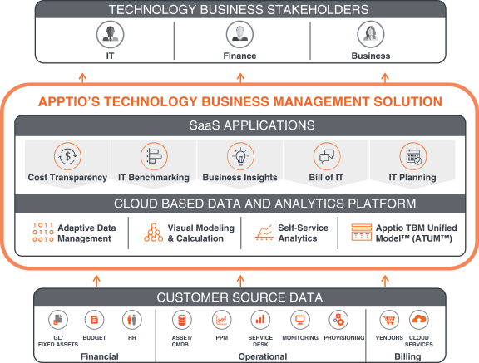
Company & Team Overview
Bellevue-based company that develops technology business management software orientated around IT cost transparency, planning, and budgeting
Team Multibox
Initial responsibility of converting software products to run in a distributed environment
Current focus on translating core software services into cloud-based microservices

Slide 3
Project Motivation
Users can upload data directly to Apptio’s Flagship service (BIIT)
The binary data is then stored in a table within BIIT’s MySQL
These blob store tables can become very large even after compression
Bloats the disk footprint for the MySQL instances and their backups
Customer | Blob Store
Customer 1 | 1.2 TB
Customer 2 | 777 GB
Customer 3 | 1.02 TB

Slide 4
Project: Blob Store Service
Create a data storage service for handling uploaded data blobs utilizing AWS S3 and DynamoDB
Core Components
S3, storing the actual data and creating presigned URLs
DynamoDB, storing mappings of blob IDs to S3 keys
KMS, handling CMKs for per customer object encryption
Frontdoor, Apptio’s authentication/authorization service
Apptio Kubernetes Platform, service deployment
RESTful API Outline
POST /blobs --> Presigned PUT
PUT /blobs/{ID}/complete --> 200 OK
GET /blobs/{ID} --> Presigned GET

Slide 5
Process
Design
Meeting with product stakeholders to determine requirements
Approval from the information security team
Implementation
Dividing work among team members
Participating in daily scrums to check in on progress
Using comprehensive code reviews to ensure code quality
Testing
Developing unit and functional tests to validate code

Slide 6
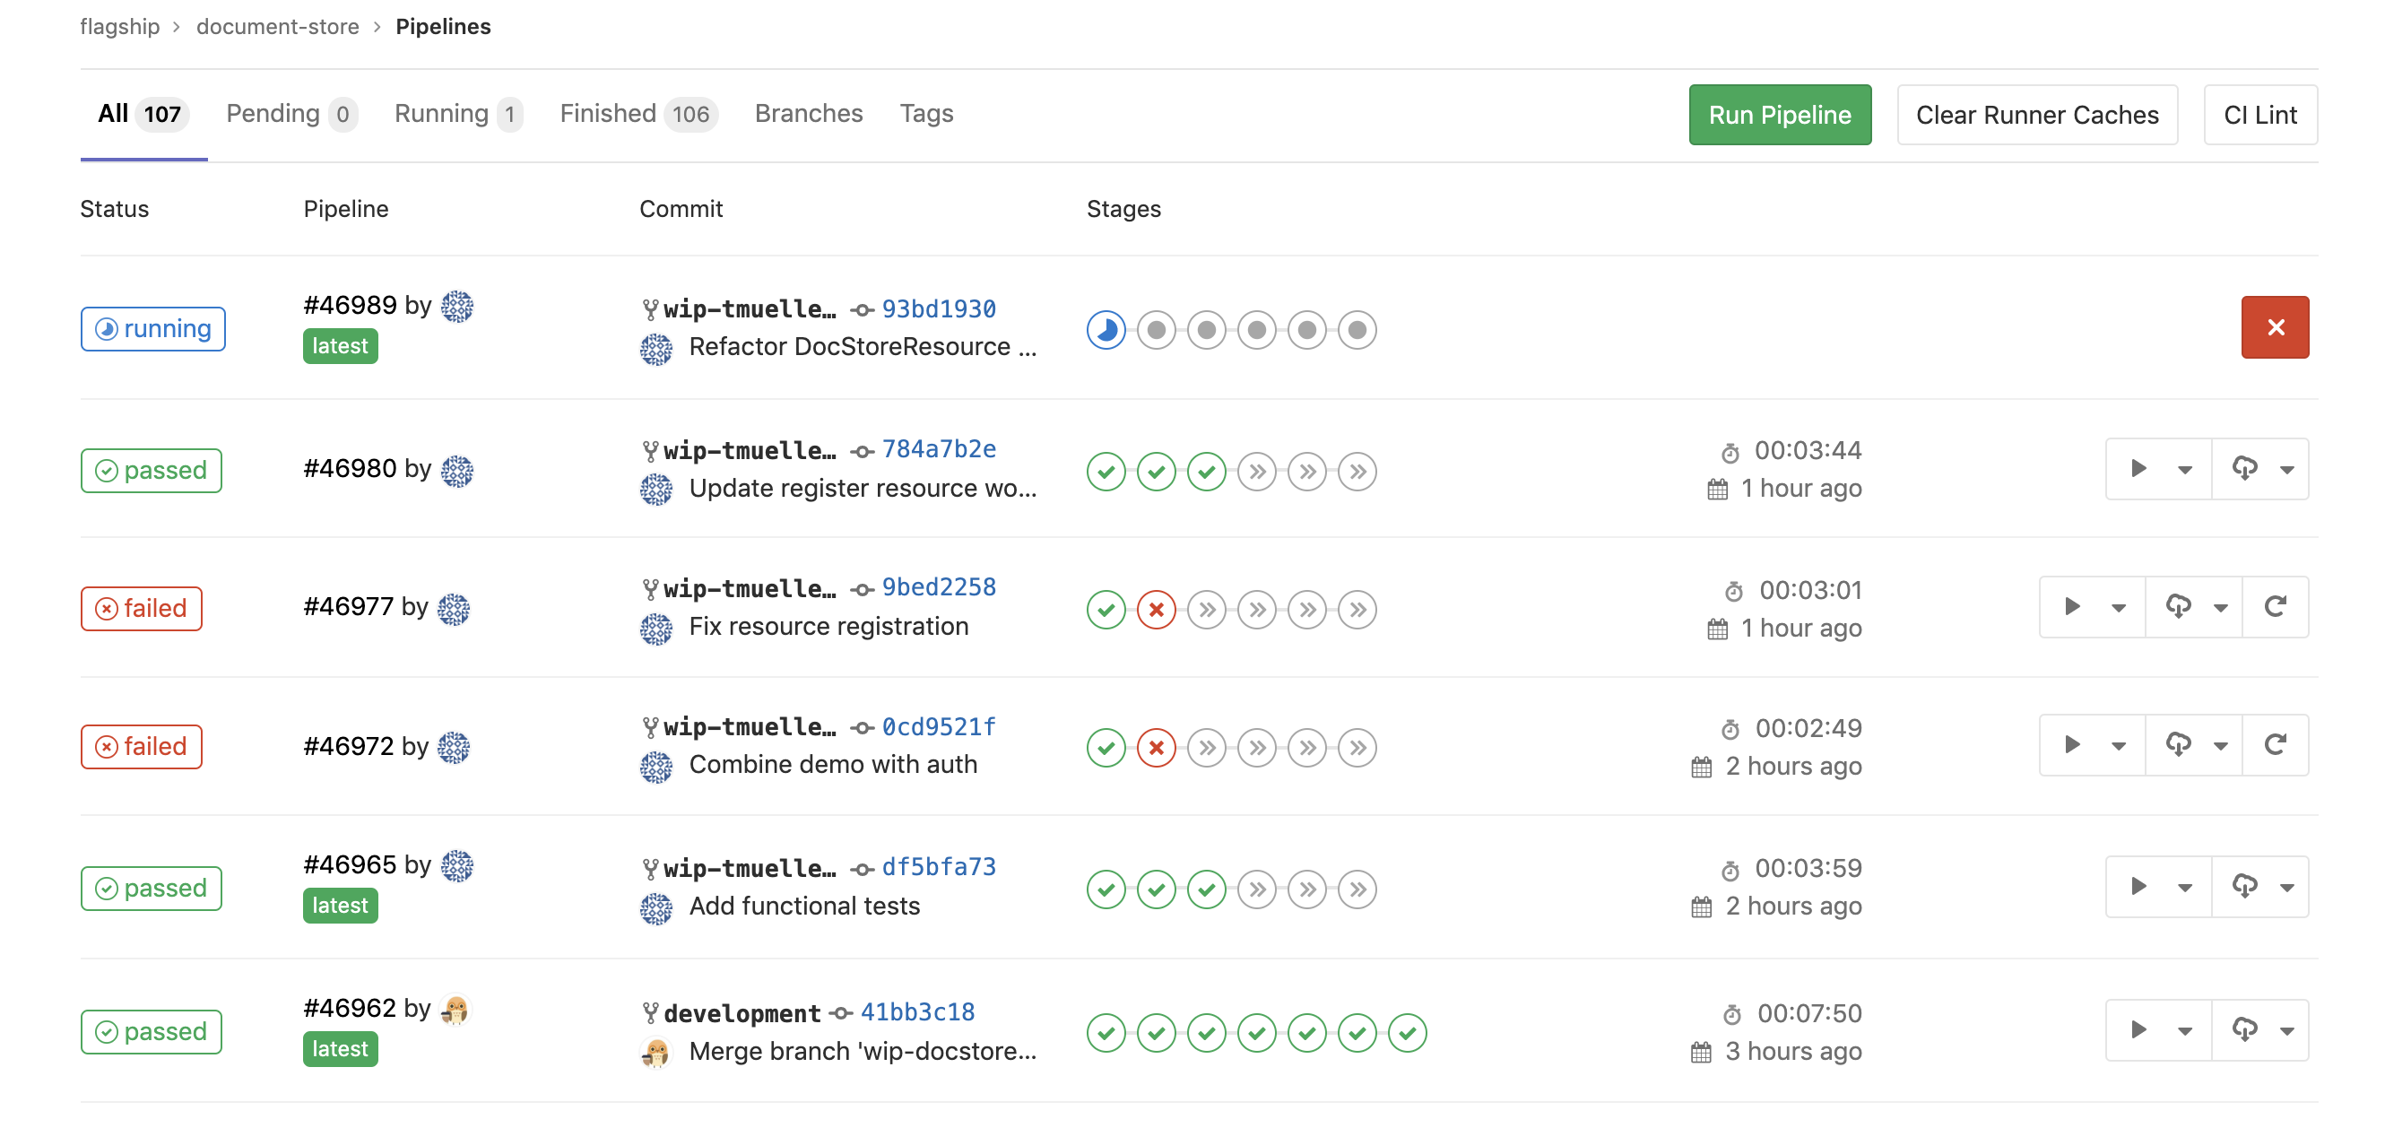
My Contributions
Project Setup
Dropwizard Gitlab repository with CI/CD
AKP deployment
S3 Module
Retrieve presigned GET/PUT URLs
Object encryption using a service generated CMK
API Endpoints
Bringing everything together
Upload and download blobs

Slide 7
Result
Implementation of the blob store’s core functionality
Development build currently deployed on AKP and capable of handling blob uploads and downloads
Object encryption based on environment ID
Authentication using Frontdoor
Experience with:
Kubernetes
RESTful APIs
AWS ecosystem
Unit and functional testing
Industry software development in a team environment

Slide 8
Challenges
Adapting to the fast pace of a professional software development environment
Understanding the numerous requirements for a piece of software to be production ready
Soliciting and incorporating feedback from team members through code reviews
Writing complete unit and functional tests

Slide 9
Relevant Courses
CSS 360 Software Engineering
CSS 370 Analysis & Design
CSS 342 & CSS 343 Data Structures, Algorithms, and Discrete Mathematics
CSS 434 Parallel & Distributed Computing

Slide 10
What’s Next?
Request authentication and authorization using Apptio’s Frontdoor system
Integration with BIIT to provide this alternative method of storing data blobs
Developing a process to convert MySQL blobs into Blob Store entries
Exploration of other Apptio services that can take advantage of this new Blob Store service

Slide 11
